Slide 1


Multi-modality classification for Alzheimer's disease based on deep learning
Presenter：Boyang Yu

Slide 2

CONTENTS
01
Background
02
Dataset
03
Research methods
04
Evaluation Standard

Slide 3
Background
The Increasing Challenges of
Alzheimer's Disease Patients
The Superiority of Deep Learning in Alzheimer's Disease Diagnosis
Alzheimer's disease is the most common type of dementia, accounting for 50-70% of all dementia cases. Globally, approximately 50 million people suffer from AD, and it is projected that by 2050, the number of patients will double. This trend undoubtedly poses a significant challenge in terms of the disease burden and healthcare costs. Early and accurate diagnosis has become a key factor in addressing this challenge.
Traditional machine learning algorithms face challenges related to dependency on expert knowledge and human errors. In contrast, deep learning exhibits end-to-end learning characteristics, allowing for direct automated feature extraction with simple preprocessing.

Slide 4
Background
The Importance of Multimodal Data in Alzheimer's Disease Diagnosis
Significance of Interpretability Methods in Deep Learning Networks
Due to the limited information in single-modal MRI image data, the use of singular modality data makes it challenging to enhance the accuracy of Alzheimer's Disease classification. In contrast, the combination of multimodal data achieves complementary information and effectively improves classification accuracy. This approach is also a future trend in the development of auxiliary diagnostics.
For medical image classification, research on model interpretability can enhance researchers' confidence in the model's judgments. When deep learning models achieve accuracy surpassing human experts, interpretability studies can assist doctors in investigating brain regions associated with Alzheimer's Disease.

Slide 5
Dataset
The datasets ADNI1, ADNIGO, ADNI2, and ADNI3 will be used for training and testing
The MCSA dataset will be used for validation.
The data includes ADNI t1 MRI images, MMSE scores, APOE4 gene information, and age. These data points are significant in staging Alzheimer's Disease (AD).

Slide 6
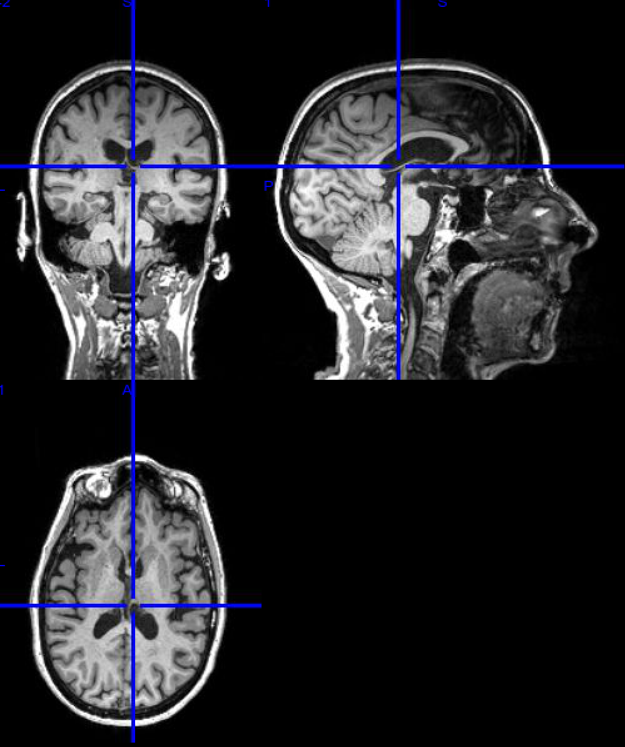
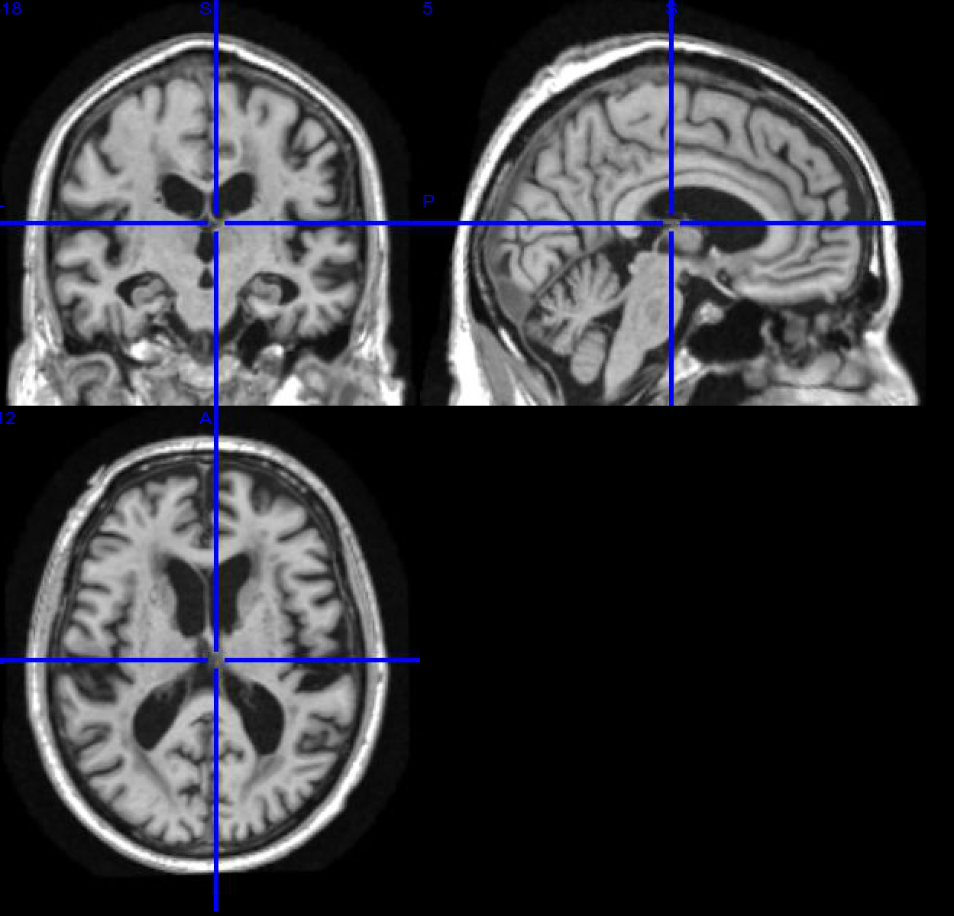
Dataset
Pre-processing
After downloading the T1 MRI images from the ADNI database, the images are register to the ADNI template space using ANTs for both linear and non-linear registration
ADNI Raw MRI T1 Data
Images to the ADNI template space

Slide 7
Dataset
Pre-processing
Next Steps：
Skull Stripping:
Load the registered T1 images into SPM.
Use the SPM skull stripping tool to remove non-brain tissues from the images. This step enhances the accuracy of subsequent tissue segmentation.
Tissue Segmentation:
Load the skull-stripped images into SPM.
Use the SPM tissue segmentation tool to segment the images into gray matter (GM), white matter (WM), and cerebrospinal fluid (CSF).

Slide 8
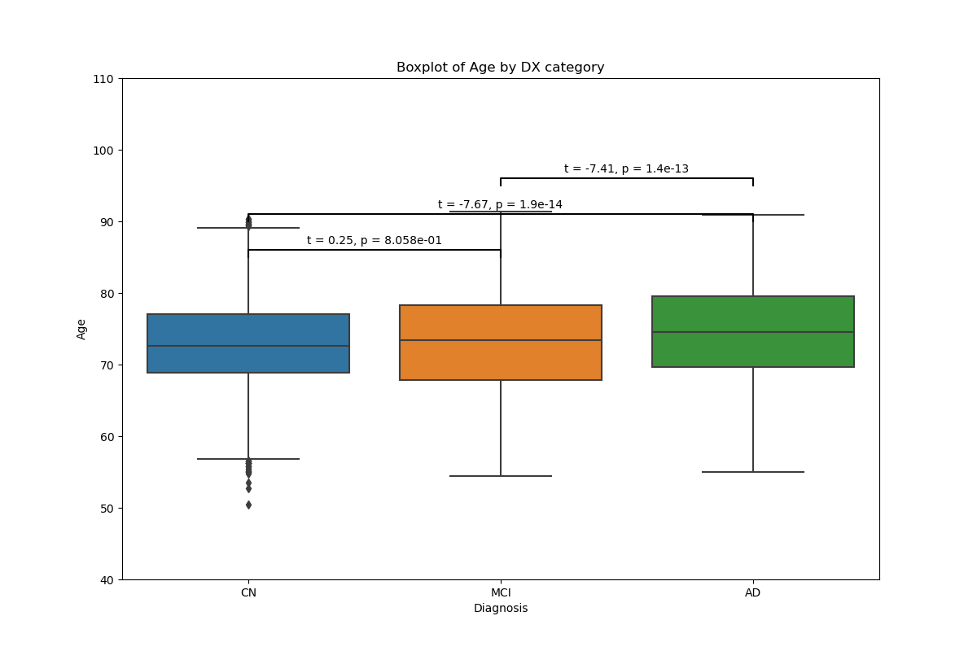
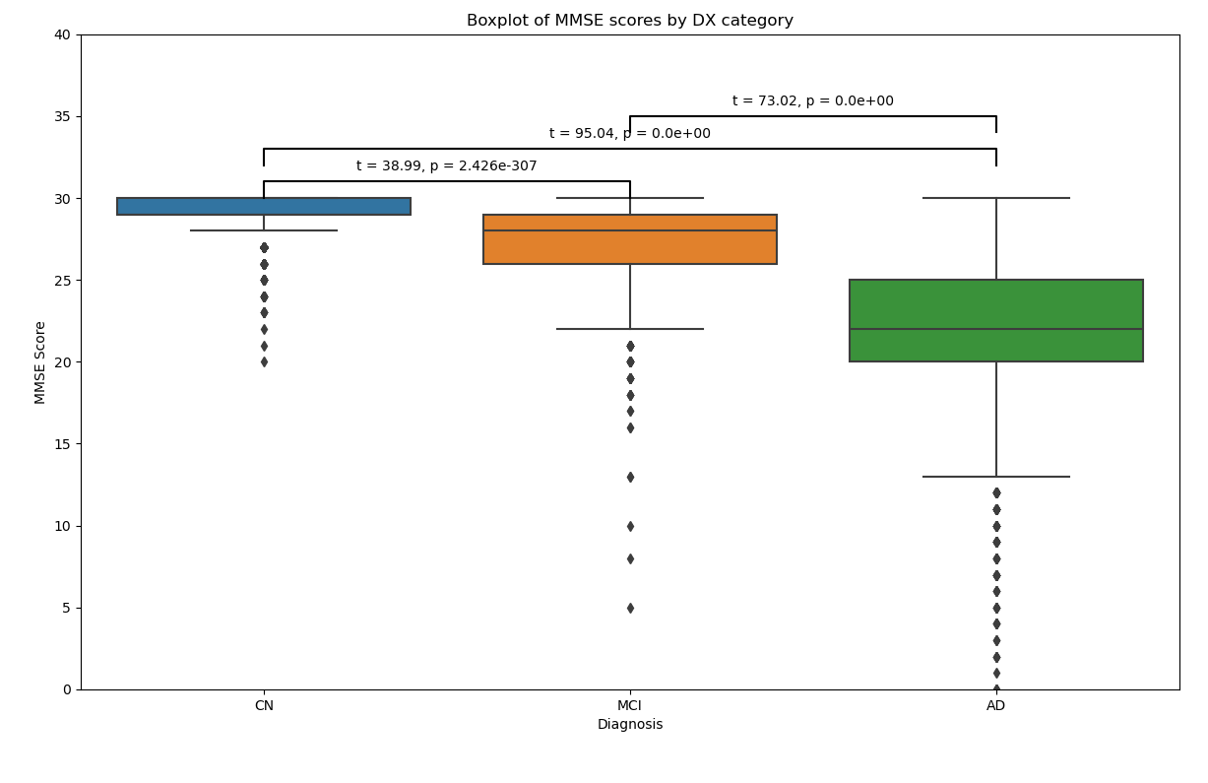
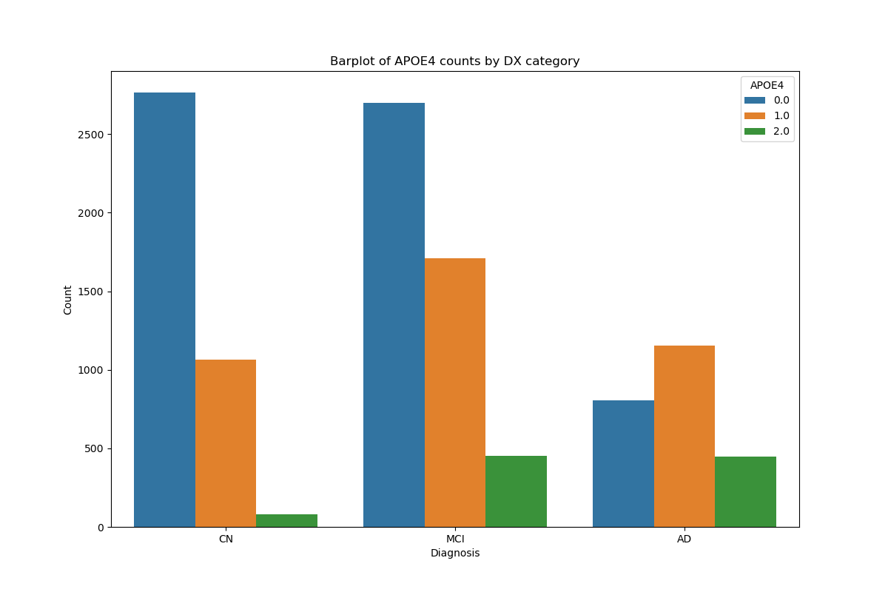
Dataset
Description for Deep Learning Input Features
The Mini-Mental State Examination (MMSE) scores, APOE4 gene information, and age are crucial factors that significantly relate to the staging of Alzheimer's Disease (AD).
This will be used as input features for the deep learning model to improve the accuracy of AD staging.
Figure 1: Boxplot of Age by Diagnosis Category
Figure 2: Boxplot of MMSE Scores by Diagnosis Category
Figure 3: Barplot of APOE4 Counts by Diagnosis
Category

Slide 9
Research Content
Data Processing
Deep Learning Model Building
collecting and preprocessing various data types, including MRI images, AGE, APOE4 gene, and MMSE scores. The preprocessing ensures the data is clean, normalized, and ready for input into the deep learning models.
In this stage, we construct deep learning models tailored to our specific research goals. These models are designed to handle complex data structures and extract meaningful patterns from the multimodal data.
01
02
Content
Data Fusion
Model Optimization
03
04
This crucial step involves integrating MRI image data with non-image data, such as AGE, APOE4 gene, and MMSE scores. The fusion of these diverse data types aims to leverage the complementary information they provide, enabling a more comprehensive analysis and improving diagnostic accuracy.
Finally, we focus on optimizing the deep learning models to enhance their performance. This includes fine-tuning hyperparameters, implementing advanced optimization algorithms, and employing validation techniques to ensure the models generalize well to new, unseen data.

Slide 10
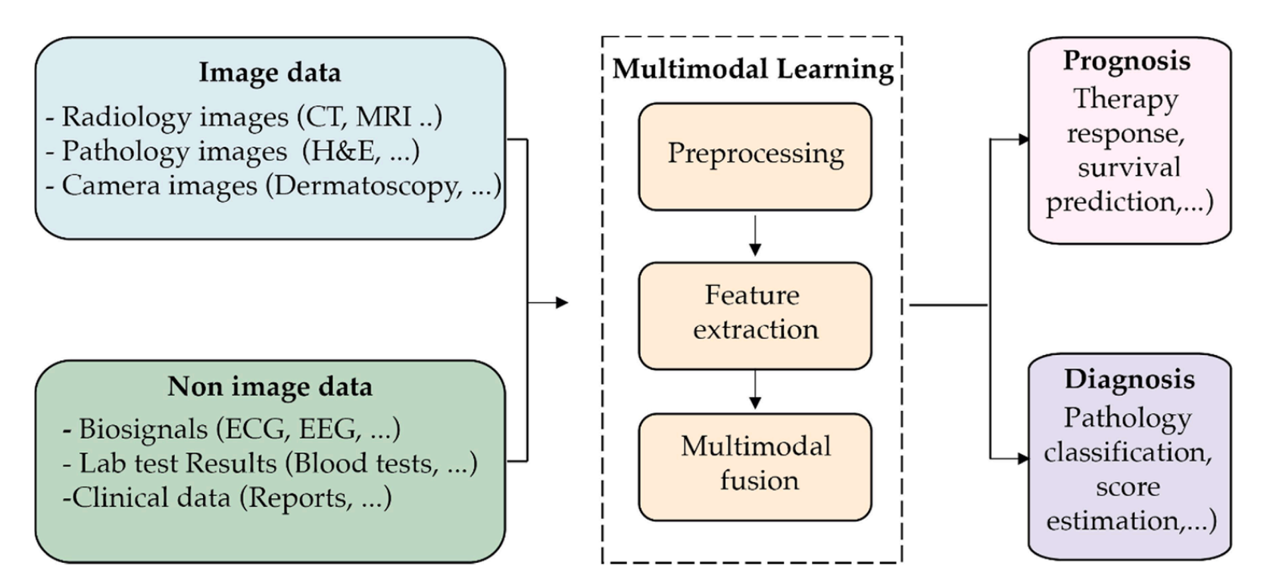
Research methods
A overview of multimodality in healthcare
Notes:
This presents an overview of multimodality in healthcare. The figure illustrates how multiple data types, such as MRI images, AGE, APOE4 gene, and MMSE scores, are collected from patients and processed through multimodal learning. This data undergoes steps like preprocessing, feature extraction, and fusion to enable diagnosis and prognosis. The figure emphasizes the importance of integrating various data types, including medical images, genetic information, and clinical scores, to gain a more comprehensive assessment of patients' health conditions.

Slide 11
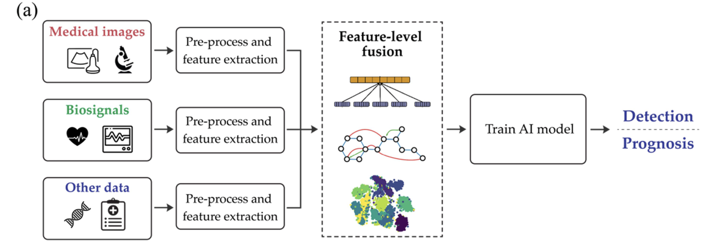
Research methods
Data Fusion Approaches
(a) Feature-level fusion
Notes:
This approach involves extracting features independently from each modality using techniques like deep learning. They are then aggregated into a joint feature representation before being input to a model for prediction

Slide 12
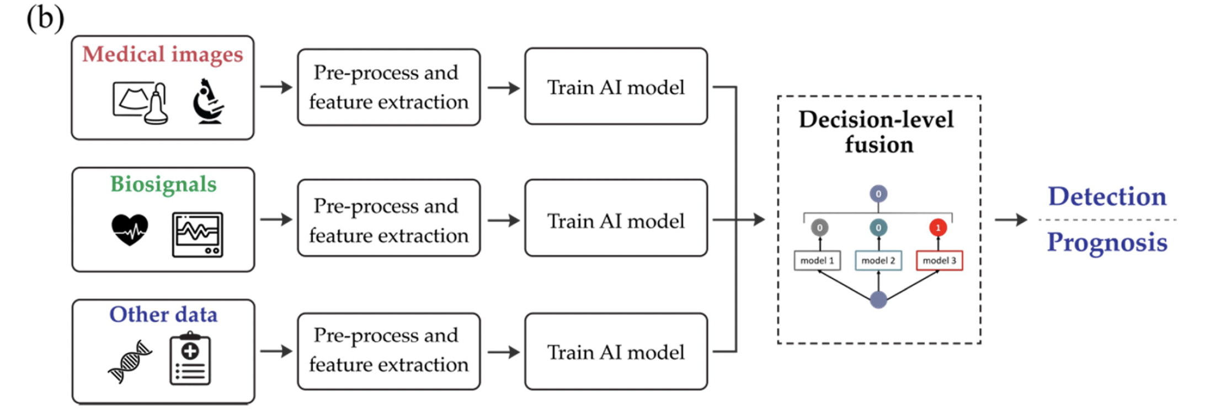
Research methods
Data Fusion Approaches
(b) Decision-level fusion.
Notes:
each modality is input to a separate model which makes an independent prediction. These predictions are then fused using methods like averaging or weighted sums to reach the final output.

Slide 13
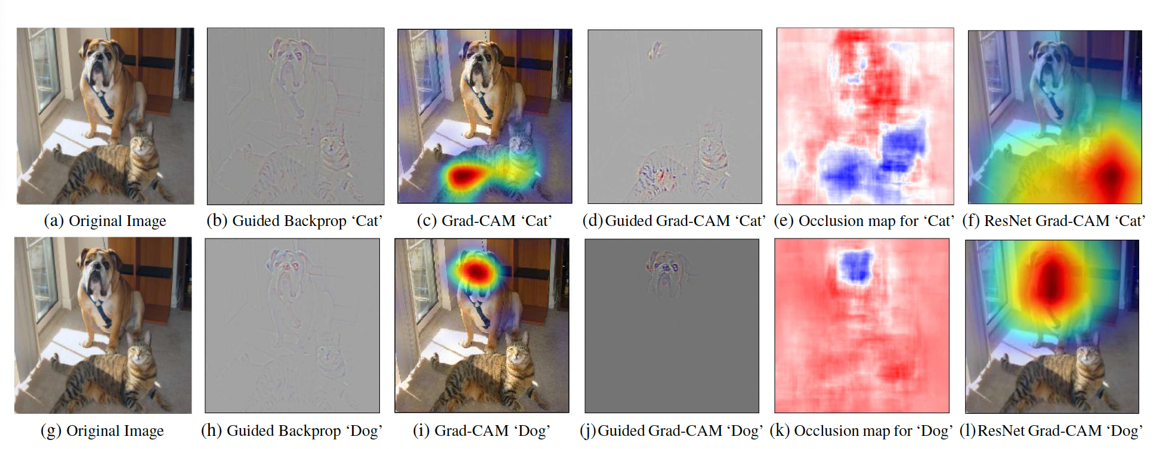
Research methods
Grad-CAM algorithm to visualization
Fig.4 Grad-CAM algorithm visualization results
Selvaraju R R, Cogswell M, Das A, et al. Grad-cam: Visual explanations from deep networks via gradient-based localiz
ation[C]//Proceedings of the IEEE international conference on computer vision. 2017: 618-626.
Notes:
。

Slide 14
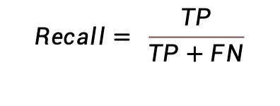
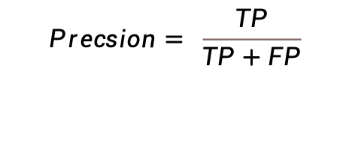
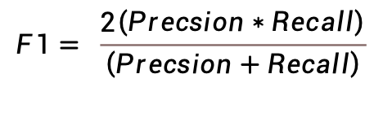
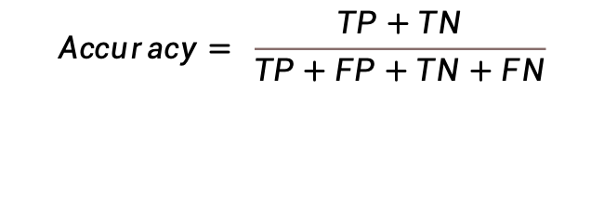
Evaluation Standard
Evaluation Standard
（1）Accuracy
（2）Precision
（3）Recall
（4）F1_score
（5）AUC（Area under the ROC curve）
$$Accuracy= \frac{TP+TN}{TP+FP+TN+FN}$$
$$Precsion= \frac{TP}{TP+FP}$$
$$Recall= \frac{TP}{TP+FN}$$
$$F1= \frac{2\left(Precsion∗Recall\right)}{\left(Precsion+Recall\right)}$$

Slide 15

Thank You！

